Slide 1
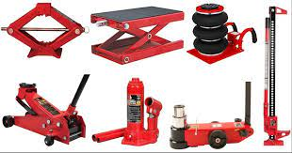
Tyre maintenance
Tools
1.Jacks
-It lifts the body of a vehicle.

Slide 2
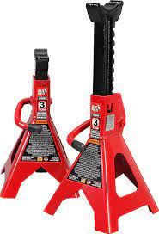
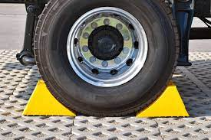
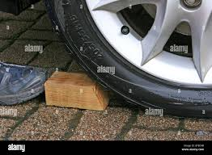
2. Jack stand
- It supports the jacked vehicle.
3.Wheel chocks or blocks of wood
- It stops the jacked vehicle from moving.
I

Slide 3

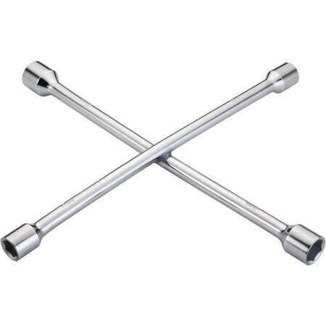
4. Triangle reflector
- It is used warn other drivers of a breakdown or crash ahead.
5. Lug wrench / wheel spanner
- It is used for tightening and loosening of bolts and nuts of car wheels.

Slide 4
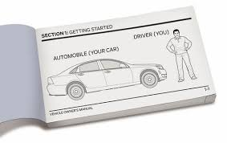
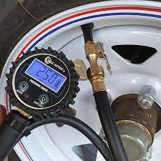
6. Owner’s manual
It is a source of artificial that employs advance technology to reduce amount of .
7. Tyre pressure gauge
- It
- It is used for cutting and stripping of wires.

Slide 5
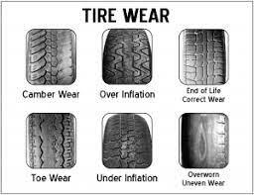
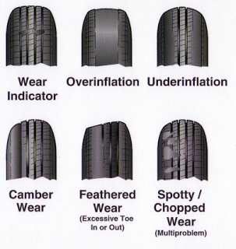
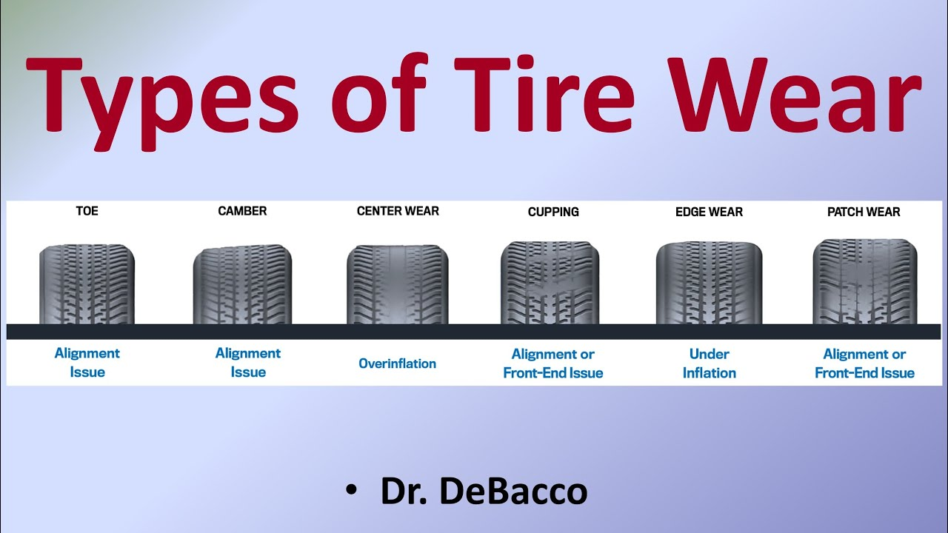
Identification of tyre tread-wear
- It is used for cutting and stripping of wires.

Slide 6
Feedback
Activity : Worksheet 5
Kwa Thema skills School
Subject : Maintenance Marks: 10
Grade : Year 2 Time : 30mins
Date :
Question : 1
1.Name five tools in tyre maintenance
1.1 ______________________________________
1.2 ______________________________________
1.3 ______________________________________
1.4 ______________________________________
1.5 ______________________________________
2.Name five tyre tread-wear
2.1 _____________________________________
2.2 _____________________________________
2.3 _____________________________________
2.4 _____________________________________
2.5 _____________________________________

